Slide 1
ME 141
Engineering Mechanics
Portion 11
Kinematics of Rigid Bodies
Partha Kumar Das
Assistant Professor
Department of Mechanical Engineering, BUET
http://parthakdas.buet.ac.bd

Slide 2
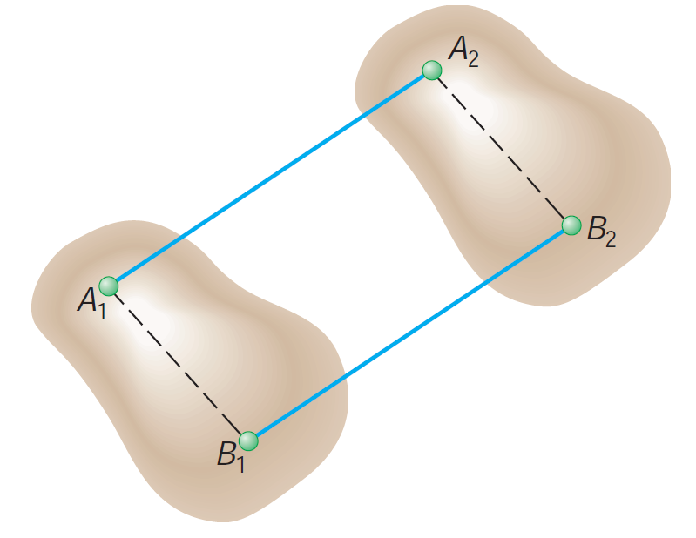
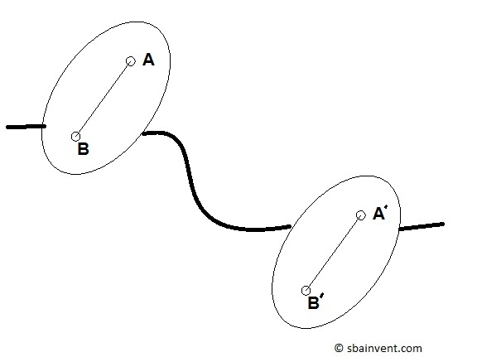
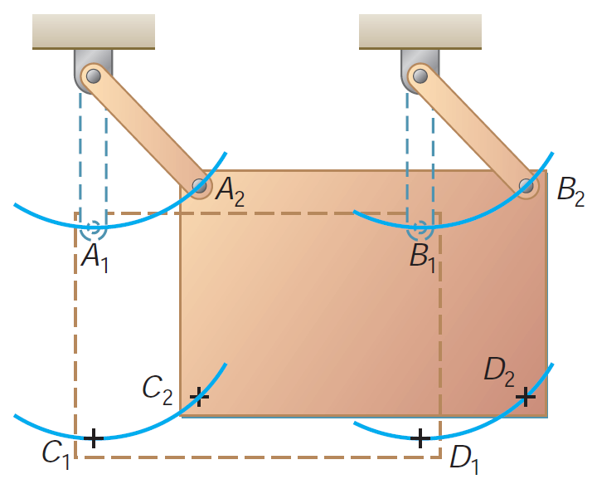
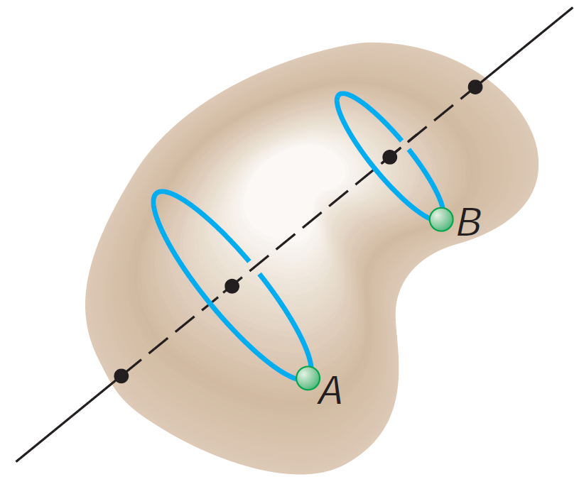
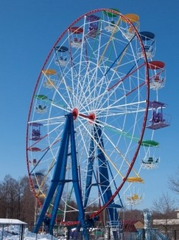
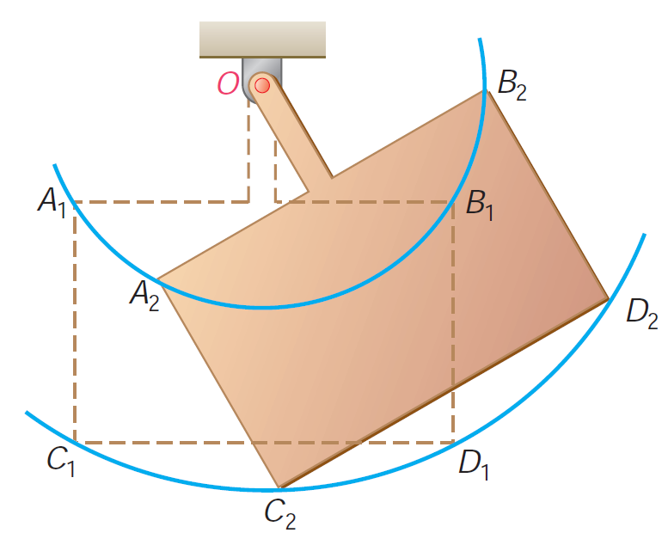
Different Types of Rigid Body Motion
Translational Motion
Rectilinear Translation
Curvilinear Translation
Curvilinear Translation
Rotational Motion

Slide 3
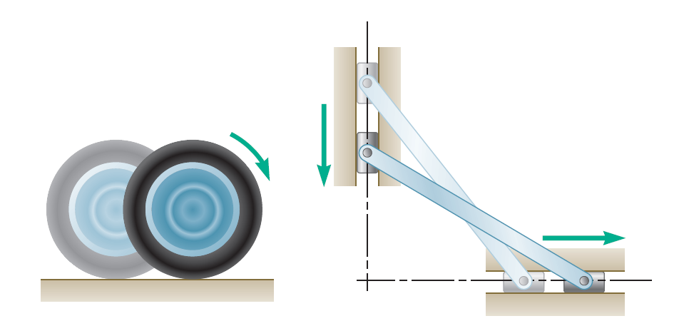
Different Types of Rigid Body Motion
General Plane Motion
Rolling Motion
Sliding Motion

Slide 4
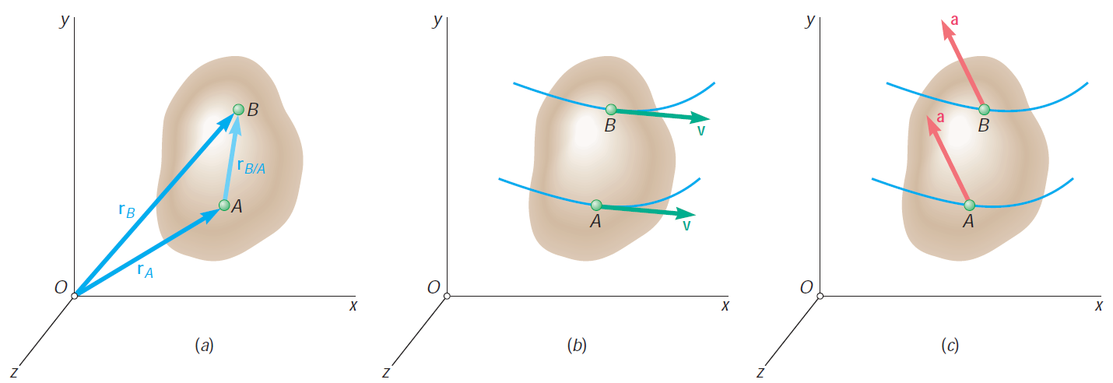
Translational Motion
$r_{B}=r_{A}$ +${ r}_{B/A}$
$$v_{B}=v_{A}$$
$$a_{B}=a_{A}$$

Slide 5
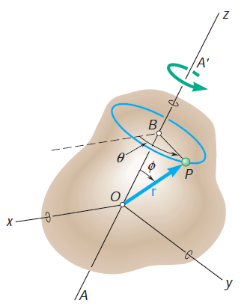
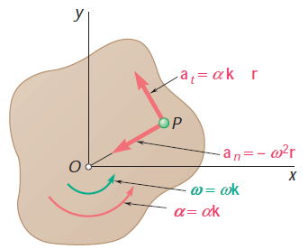
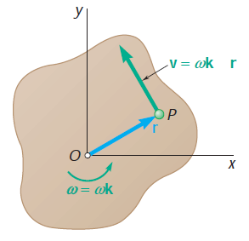
Rotational Motion
$$v=\frac{dr}{dt}= ω ×r$$
$$a=\frac{dv}{dt}=\frac{d(ω ×r \text{)}}{dt}=\frac{dω}{dt}×r+ω×\frac{dr}{dt}$$
= α $×r$ + $ω×v$
= α $×r$ + $ω×$ ($ω ×r)$
$$×$$
$$×$$
$$v=\frac{dr}{dt}=ω ×r=ω (k×r)$$
$a \text{= }\text{(}\text{α} ×r\text{)}\text{+ }ω×\text{ (}ω×r)$ = $\text{α} \text{(}\text{k}×$ r) - $ω^{2}$ r

Slide 6
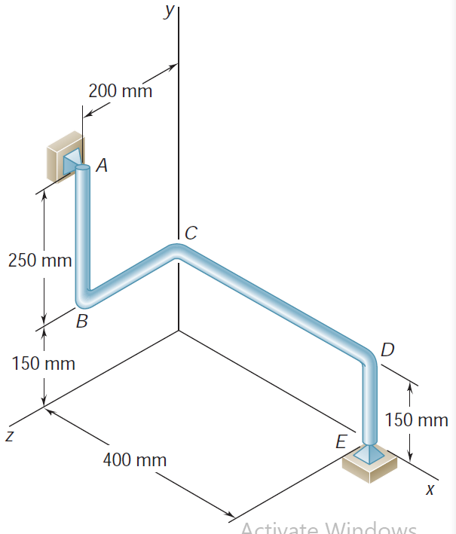
Problem 11.1 (Beer Johnston_10th edition_P15.10)
The bent rod ABCDE rotates about a line joining Points A and E with a constant angular velocity of 9 rad/s. Knowing that the rotation is clockwise as viewed from E, determine the velocity and acceleration of corner C.

Slide 7
General Plane Motion

Slide 8
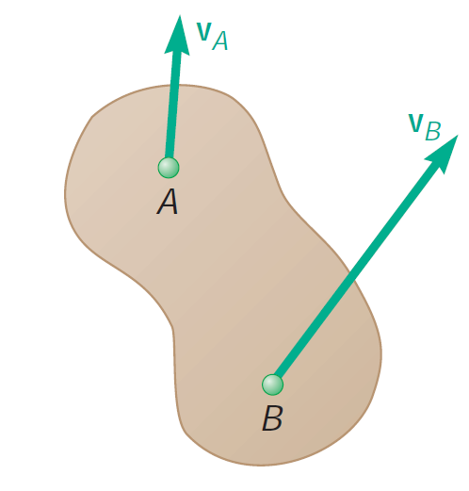
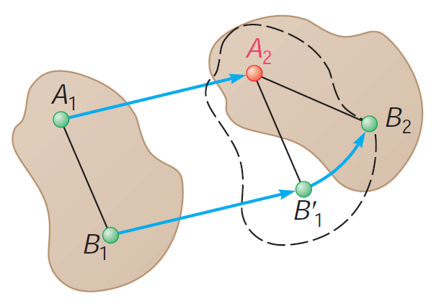
General Plane Motion: Describing the Motion

Slide 9
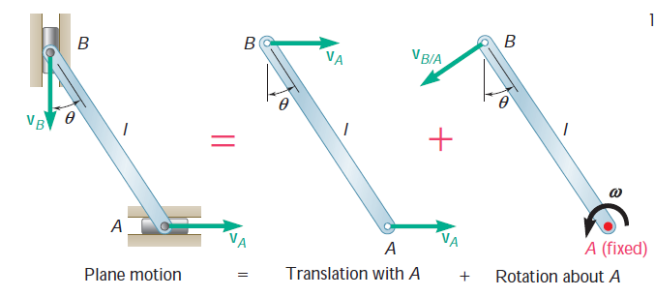
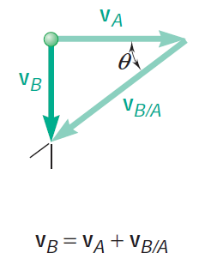
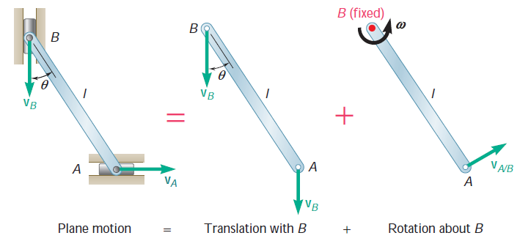
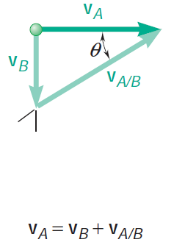
General Plane Motion: Describing the Motion

Slide 10
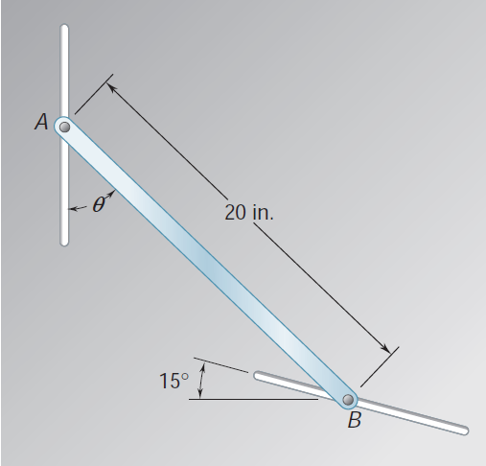
Problem 11.2 (Beer Johnston_10th edition_P15.39)
The motion of rod AB is guided by pins attached at A and B which slide in the slots shown. At the instant shown, θ = 40° and the pin at B moves upward to the left with a constant velocity of 6 in./s.
Determine
the angular velocity of the rod,
the velocity of the pin at end A.
ANS.: $v_{A}$ = 6.42 in/sec $, ω$ = 0.378 rad/sec

Slide 11
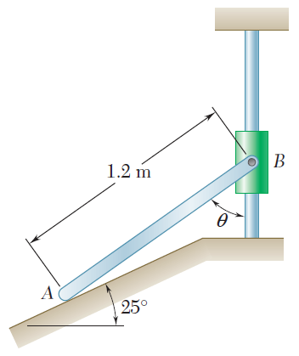
Problem 11.3 (Beer Johnston_10th edition_P15.40)
Collar B moves upward with a constant velocity of 1.5 m/s. At the instant when θ = 50°, determine
the angular velocity of rod AB,
the velocity of end A of the rod.
ANS.: $v_{A}$ = 0.998 m/sec $, ω$ = 1.173 rad/sec

Slide 12
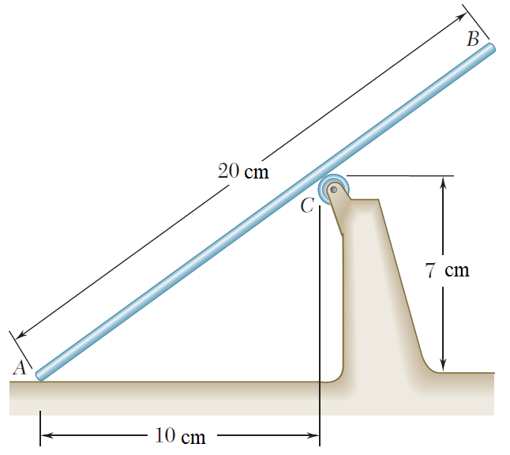
Problem 11.4 (Beer Johnston_10th edition_P15.43)
Rod AB moves over a small wheel at C while end A moves to the right with a
constant velocity of 25 cm./s. At the instant shown, determine
the angular velocity of the rod,
the velocity of end B of the rod.
ANS.: $ω$ = 1.175 rad/sec , $v_{B}$ = 22.4 cm/sec 59.1°

Slide 13
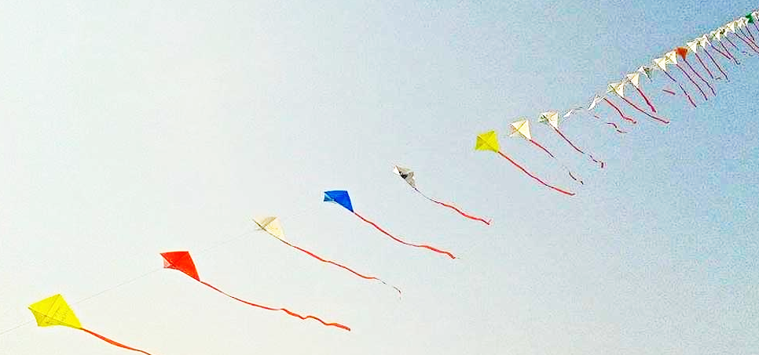
END OF PORTION 11
That’s all for the Term
Be Calm in Failure.
Because real failure does not need any excuse to show.
Thank you for your Attention.
Wish You the Best of Luck.

Slide 14
References
Vector Mechanics for Engineers: Statics and Dynamics
Ferdinand Beer, Jr., E. Russell Johnston, David Mazurek, Phillip Cornwell.

